Slide 1
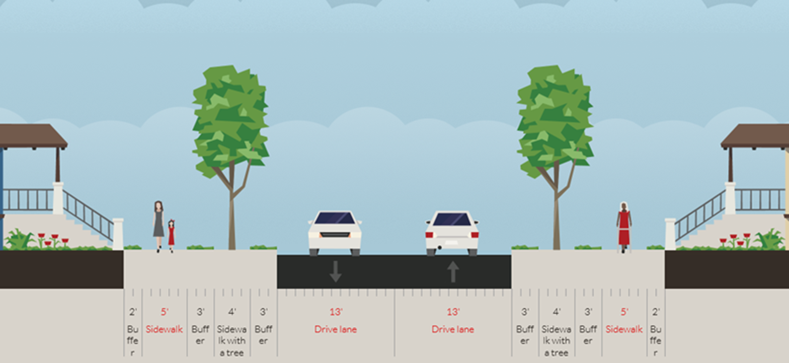
60-feet R-O-W
(Typical)

Slide 2
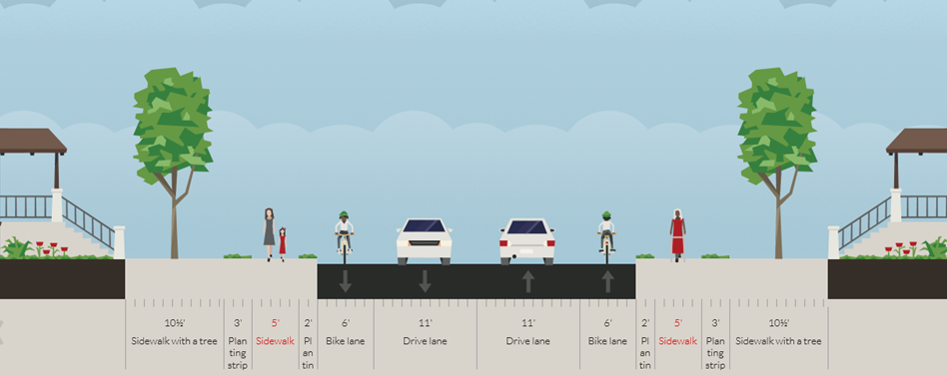
75-feet R-O-W
(Option 2 – Bike Lane)

Slide 3
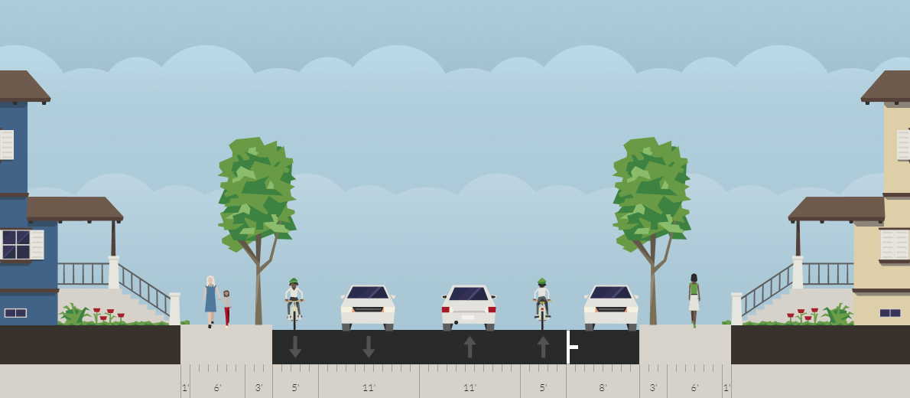
75-feet R-O-W
(Option 4 – 40 feet PVMNT)

Slide 4
Fairview Comparison
STREET PARKING
DEDICATED BIKE LANES
Pros
  Dedicated parking lanes
Cons
  More impacts to landscaping.
Pros
  Safe route for cyclists
Cons
  Limited parking along Fairview
  Potential conflict at Shepherd Drive intersection.

Slide 5
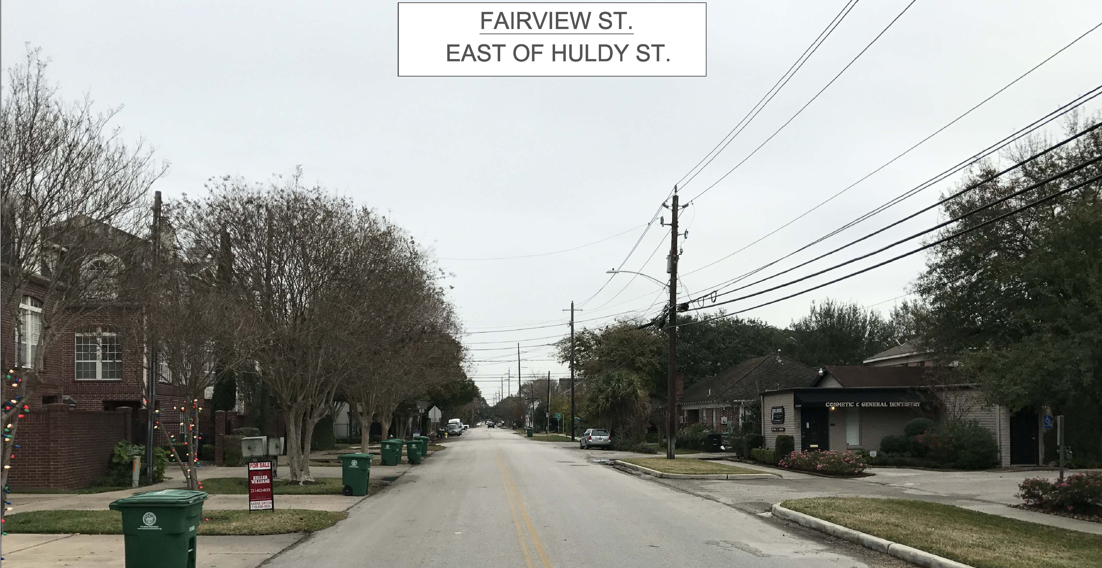
Avalon Place
Existing Fairview Right-of-Way
Pavement Width Varies (27’ to 40’)
75’ EXISTING ROW

Slide 6
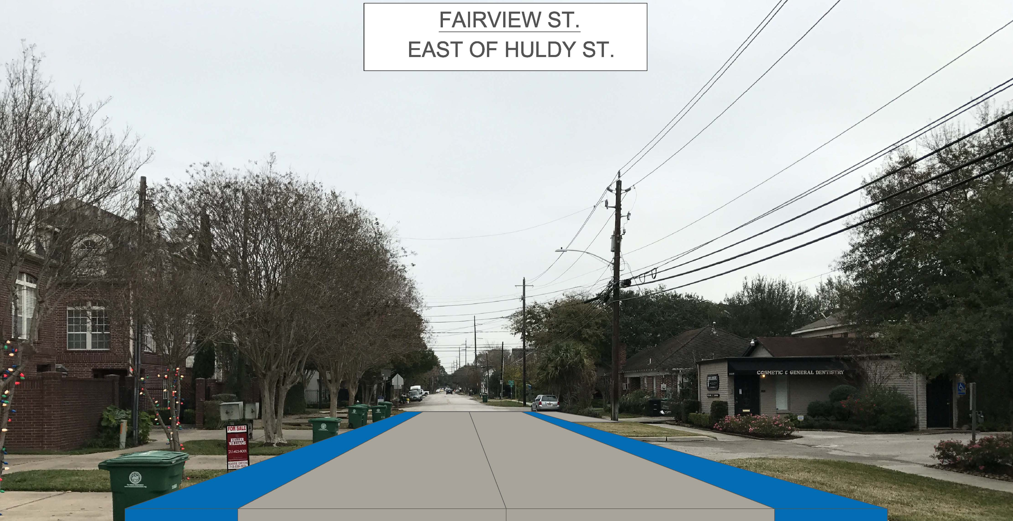
Avalon Place
Proposed Fairview Right-of-Way
Street Parking to Match Existing
*Note:
Sidewalk not shown but will be designed to minimize community impacts.
5.5’ Bike Lane
22’ Proposed Pavement Width
5.5’ Bike Lane
75’ EXISTING ROW

